Slide 1




ENHANCING USER EXPERIENCE BY LEVERAGING WEB SCRAPING

Slide 2
INTRODUCTION
In the current digital age , where information is abundant but often scattered across various websites, our project focuses on providing users with direct access to relevant information by utilizing web scraping techniques
2

Slide 3
PROBLEM STATEMENT
Accessing direct and relevant information on the web is challenging due to scattered data, reliance on indirect references, and manual searching. This scattered information hinders user experience by causing inefficiencies, frustration, and information overload.
ENHANCING USER EXPERIENCE BY LEVERAGING WEB SCRAPING
3

Slide 4
SOLUTION
Automated Data Extraction: Use web scraping to automatically gather information from diverse websites.
Structured Data Collection: Organize the scraped data into structured formats for easy analysis and retrieval.
Customized Information Retrieval: Tailor web scraping to deliver specific data according to user preferences.
ENHANCING USER EXPERIENCE BY LEVERAGING WEB SCRAPING
4

Slide 5
BLOCK DIAGRAM
GETTING RESULTS
result 1
query
search
engines
result 2
the basic idea is to enter our query in multiple
search engines and scraping urls from those
result n
ENHANCING USER EXPERIENCE BY LEVERAGING WEB SCRAPING
5

Slide 6
BLOCK DIAGRAM
In the 'Top 'm' Results' stage, we are not creating a search engine. Instead, we are identifying the most repeated URLs from multiple search engines to ensure the selection of the most relevant and reliable sources of information for further processing
FINDING BEST RESULTS
result 1
result 2
TOP ‘m’
RESULTS
result n
ENHANCING USER EXPERIENCE BY LEVERAGING WEB SCRAPING
6

Slide 7
BLOCK DIAGRAM
DATA EXTRACTION AND PROCESSING
TOP ‘m’
RESULTS
DATA EXTRACTION
DATA
PROCESSING
Data extraction is performed using web scraping techniques, enabling the retrieval of relevant information from various online sources. Subsequently, the extracted data undergoes processing to meet specific requirements.
An example for data processing is using summarizer.
[in our code the summarizer we use is pretrained ml model].
ENHANCING USER EXPERIENCE BY LEVERAGING WEB SCRAPING
7

Slide 8
BLOCK DIAGRAM
SAVING DATA AND PROVIDING UNIFIED VIEW
DATA
PROCESSING
SAVING DATA
PROVIDING
UNIFIED VIEW
Saving data can involve either inserting it into a database for structured storage and retrieval, or saving it into a CSV or TXT file for easy access and analysis .
Providing a unified view involves presenting the saved data within a web application.
ENHANCING USER EXPERIENCE BY LEVERAGING WEB SCRAPING
8

Slide 9
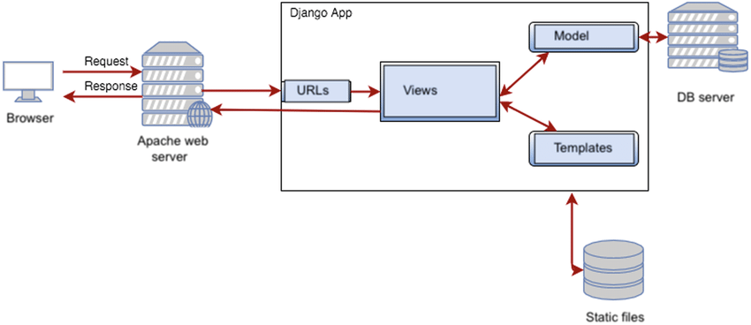
SYSTEM ARCHITECTURE
ENHANCING USER EXPERIENCE BY LEVERAGING WEB SCRAPING
9

Slide 10
TOOLS USED FOR WEBSCRAPING
PYTHON
1. Extensive Library Support:
Python offers a vast array of libraries tailored for web scraping tasks.
Libraries like BeautifulSoup and Scrapy simplify tasks such as HTML parsing and HTTP requests.
2. Ease of Use:
Python's simple syntax and high-level abstractions make it accessible to developers of all skill levels.
Its readability and expressiveness enhance productivity in web scraping projects.
3. Scalability and Performance:
Python supports projects of varying complexities, from simple scripts to large-scale data extraction pipelines.
Integration with performance-enhancing libraries like Cython ensures efficient handling of large datasets.
4. Export Flexibility:
Python enables easy exporting of scraped data to popular formats like CSV, JSON, and Excel.
This versatility facilitates seamless integration with other systems and diverse data processing workflows.
ENHANCING USER EXPERIENCE BY LEVERAGING WEB SCRAPING
10

Slide 11
FRONT END TECHNOLOGIES
HTML (Hypertext Markup Language):
Provides the structure and content of web pages.
Defines the elements and layout of the webpage.
CSS (Cascading Style Sheets):
Styles the HTML elements, controlling their appearance and layout.
Defines the visual presentation of the webpage, including colors, fonts, and spacing.
JavaScript:
Adds interactivity and dynamic behavior to the webpage.
Enables client-side scripting, allowing for features like form validation, animations, and DOM manipulation.
ENHANCING USER EXPERIENCE BY LEVERAGING WEB SCRAPING
11

Slide 12
TOOLS USED FOR FRAMEWORK
Django:
High-level Python web framework for rapid development of web applications.
Provides built-in features like authentication, routing, and ORM for efficient development.
SQLite:
We opted for SQLite as the database system for our project because it's lightweight and easy to use. It doesn't require a separate server and can be integrated seamlessly into our application. Additionally, SQLite databases work across different platforms, ensuring compatibility. Overall, SQLite provides a straightforward and reliable solution that fits our project's needs
ENHANCING USER EXPERIENCE BY LEVERAGING WEB SCRAPING
12

Slide 13
IMPORTED MODULES
Requests:
Purpose: HTTP library for making requests and retrieving data from web pages.
Example: Used to fetch web page content for scraping.
Beautiful Soup (bs4):
Purpose: HTML/XML parsing library for extracting data from web pages.
Example: Used to navigate and extract specific elements from HTML documents.
JSON :
Module for reading and writing JSON (JavaScript Object Notation) files
ENHANCING USER EXPERIENCE BY LEVERAGING WEB SCRAPING
13

Slide 14
IMPORTED MODULES
4.Selenium Webdriver:
Purpose: Web automation tool for controlling web browsers and simulating user interactions.
Example: Used for tasks like filling out forms, clicking buttons, and navigating dynamically generated content
ENHANCING USER EXPERIENCE BY LEVERAGING WEB SCRAPING
14

Slide 15
WEB SCRAPING
Web scraping is a technique used to extract data from websites. It involves automating the process of fetching web pages, parsing the HTML content, and extracting the desired information. There are primarily two types of web scraping techniques:
1.Static Web Scraping
2.Dynamic Web Scraping
ENHANCING USER EXPERIENCE BY LEVERAGING WEB SCRAPING
15

Slide 16
Static Web Scraping:
Static web scraping involves extracting data from web pages with fixed content that doesn't change frequently. It typically follows these steps:
HTTP Request: The scraping program sends an HTTP request to the web server to retrieve the HTML content of the target web page.
HTML Parsing: The received HTML content is parsed using libraries like BeautifulSoup. This allows the program to navigate through the HTML structure and extract relevant data.
Data Extraction: The program identifies specific HTML elements containing the desired data, such as text, images, or links, and extracts them.
Data Processing: The extracted data may undergo further processing, such as cleaning, formatting, or filtering, to prepare it for analysis or storage.
ENHANCING USER EXPERIENCE BY LEVERAGING WEB SCRAPING
16

Slide 17
Dynamic Web Scraping:
Dynamic web scraping is more complex and involves extracting data from web pages with dynamic content that changes based on user interactions or other factors. It typically follows these steps:
Browser Automation: Dynamic scraping often requires browser automation tools like Selenium to interact with the web page as a human user would. This allows the program to handle JavaScript execution and AJAX requests.
Page Rendering: The web page is rendered in a browser window controlled by Selenium, allowing the program to access the dynamically generated content.
Content Extraction: Similar to static scraping, the program extracts the desired data from the rendered page using techniques like XPath or CSS selectors.
Data Processing: The extracted data is processed as needed, just like in static scraping, before being stored or further analyzed.
ENHANCING USER EXPERIENCE BY LEVERAGING WEB SCRAPING
17

Slide 18
MODULE - 1
ENHANCING USER EXPERIENCE BY LEVERAGING WEB SCRAPING
18

Slide 19
Weather Data Aggregator
Google Search Integration: We've integrated Google search functionality to enhance our system's ability to fetch relevant product listings based on user input. Leveraging Google's search algorithms ensures that we provide accurate and comprehensive data, enriching the user experience.
Web Automation: The web automation part of the code initiates a Google search for the IMDb page of a given movie. It retrieves the search results, finds the IMDb link, and navigates to the IMDb page. Using Beautiful Soup and JSON parsing, it extracts movie information such as rating and summary. Finally, it saves the extracted information to the database.
.
ENHANCING USER EXPERIENCE BY LEVERAGING WEB SCRAPING
19

Slide 20
Weather Data Aggregator
Data Processing: Parses the extracted weather data, including dates, high and low temperatures, into a structured format. Handles the scenario where the temperature information may contain percentage symbols, indicating humidity.
Data Analysis and Presentation: analyzes scraped weather data, such as high temperature and low temperature . Presents this data in a User friendly way through graphical representations such as line graphs . Additionally, our project condenses important information into easy-to-read reports, presenting daily, weekly, or monthly summaries along with forecast analyses.
ENHANCING USER EXPERIENCE BY LEVERAGING WEB SCRAPING
20

Slide 21
MODULE - 2
ENHANCING USER EXPERIENCE BY LEVERAGING WEB SCRAPING
21

Slide 22
FilmInsight Viewer
Google Search Integration: We've integrated Google search functionality to enhance our system's ability to fetch relevant product listings based on user input. Leveraging Google's search algorithms ensures that we provide accurate and comprehensive data, enriching the user experience.
Web Automation: Our system utilizes web automation techniques to seamlessly navigate to corresponding IMBD sites from Google search results. This automation streamlines the process, enabling our system to access the required site with more accuracy.
ENHANCING USER EXPERIENCE BY LEVERAGING WEB SCRAPING
22

Slide 23
FilmInsight Viewer
Data Extraction and Parsing: We extract movie information, including name, rating, and summary, by parsing HTML content with BeautifulSoup and JSON parsing. This allows us to efficiently retrieve and process data from IMDb pages.
Error Handling: We implement robust error handling mechanisms to gracefully manage unexpected situations, ensuring reliability and user satisfaction. By anticipating potential errors and implementing appropriate strategies, we enhance the stability of our system.
ENHANCING USER EXPERIENCE BY LEVERAGING WEB SCRAPING
23

Slide 24
Actor Data Scraper
Google Se﻿arch Integration: We've integrated Google search functionality to enhance our system's ability to fetch relevant product listings based on user input. Leveraging Google's search algorithms ensures that we provide accurate and comprehensive data, enriching the user experience.
Web Automation: Our system utilizes web automation techniques to seamlessly navigate to wikipedia site from Google search results.
ENHANCING USER EXPERIENCE BY LEVERAGING WEB SCRAPING
24

Slide 25
Actor Data Scraper
Data Extraction and Parsing: After reaching the Wikipedia page, we extract movie titles from the filmography tables, excluding header rows, and compile them into a list. This comprehensive approach ensures accurate and reliable extraction of movie data, providing valuable insights into the actor's career.
Error Handling: To ensure the reliability and stability of our data extraction process, we implement robust error handling mechanisms. During the scraping process, we encounter various exceptions, such as element not found errors or connection timeouts. We use retry mechanisms to avoid this and successfully navigate to required page.
ENHANCING USER EXPERIENCE BY LEVERAGING WEB SCRAPING
25

Slide 26
MODULE - 3
ENHANCING USER EXPERIENCE BY LEVERAGING WEB SCRAPING
26

Slide 27
PRICE COMPARATOR
Google Search Integration: We've integrated Google search functionality to enhance our system's ability to fetch relevant product listings based on user input. Leveraging Google's search algorithms ensures that we provide accurate and comprehensive data, enriching the user experience.
Web Automation: Our system utilizes web automation techniques to seamlessly navigate to corresponding shopping sites from Google search results. This automation streamlines the process, enabling our system to access product pages quickly and efficiently without manual intervention, ultimately saving time for the user.
Error Handling: We implement robust error handling mechanisms to gracefully handle unexpected situations, ensuring reliability and user satisfaction.
ENHANCING USER EXPERIENCE BY LEVERAGING WEB SCRAPING
27

Slide 28
PRICE COMPARATOR
Data Scraping: Utilize Requests library to scrape essential product details, including prices, from targeted shopping sites' web pages.
Smart Price Comparison: Implement an algorithm to analyze scraped data and present users with links to the shopping site offering the product at the most competitive price.
Multi-Threaded Programming: To further enhance performance, we've implemented multi-threaded programming. By creating separate threads for each shopping site, our system can simultaneously scrape data from multiple sources, significantly reducing the time taken to fetch information. This approach ensures faster response times and improved user satisfaction.
ENHANCING USER EXPERIENCE BY LEVERAGING WEB SCRAPING
28

Slide 29
MODULE - 4
ENHANCING USER EXPERIENCE BY LEVERAGING WEB SCRAPING
29

Slide 30
DOUBT RESOLVE
Multi-Search Integration: Seamlessly integrates multiple search engines to retrieve the most relevant results for user-entered doubts.
Getting Best Search Results: Utilizes count module and identify the most frequently repeated results across multiple sites, ensuring users receive the most accurate and reliable information.
Web Automation: Incorporates web automation techniques to streamline the process of searching and retrieving data from multiple sites, optimizing efficiency and accuracy.
ENHANCING USER EXPERIENCE BY LEVERAGING WEB SCRAPING
30\

Slide 31
DOUBT RESOLVE
Multi-Threaded Programming: To further enhance performance, we've implemented multi-threaded programming. By creating separate threads for each shopping site, our system can simultaneously scrape data from multiple sources, significantly reducing the time taken to fetch information. This approach ensures faster response times and improved user satisfaction.
Data Scraping and Summarization: Gathers data from various sources and utilizes a pretrained BERT model for summarization, ensuring concise and informative summaries.
User-Friendly Presentation: Presents each summarized text alongside its reference link in a user-friendly format for easy understanding.
ENHANCING USER EXPERIENCE BY LEVERAGING WEB SCRAPING
31

Slide 32
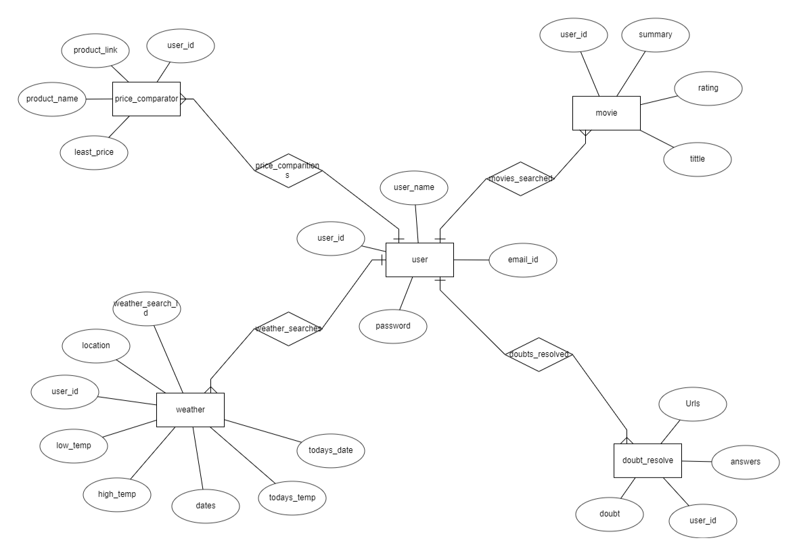
DATA BASE ER DIAGRAM :-
ENHANCING USER EXPERIENCE BY LEVERAGING WEB SCRAPING
32

Slide 33
DATA BASE :-
In our Project Data base is used to show history to user.
Weather data aggregator: store dates and temperatures .
Film Insight Viewer : stores movie name , rating and summary .
Price Comaparator : stores product name, least price and url where least price is available.
Doubt Resolve : stores doubt , 3 summaries , 3 urls from where it is collected
ENHANCING USER EXPERIENCE BY LEVERAGING WEB SCRAPING
33

Slide 34
RESULTS
ENHANCING USER EXPERIENCE BY LEVERAGING WEB SCRAPING
34

Slide 35
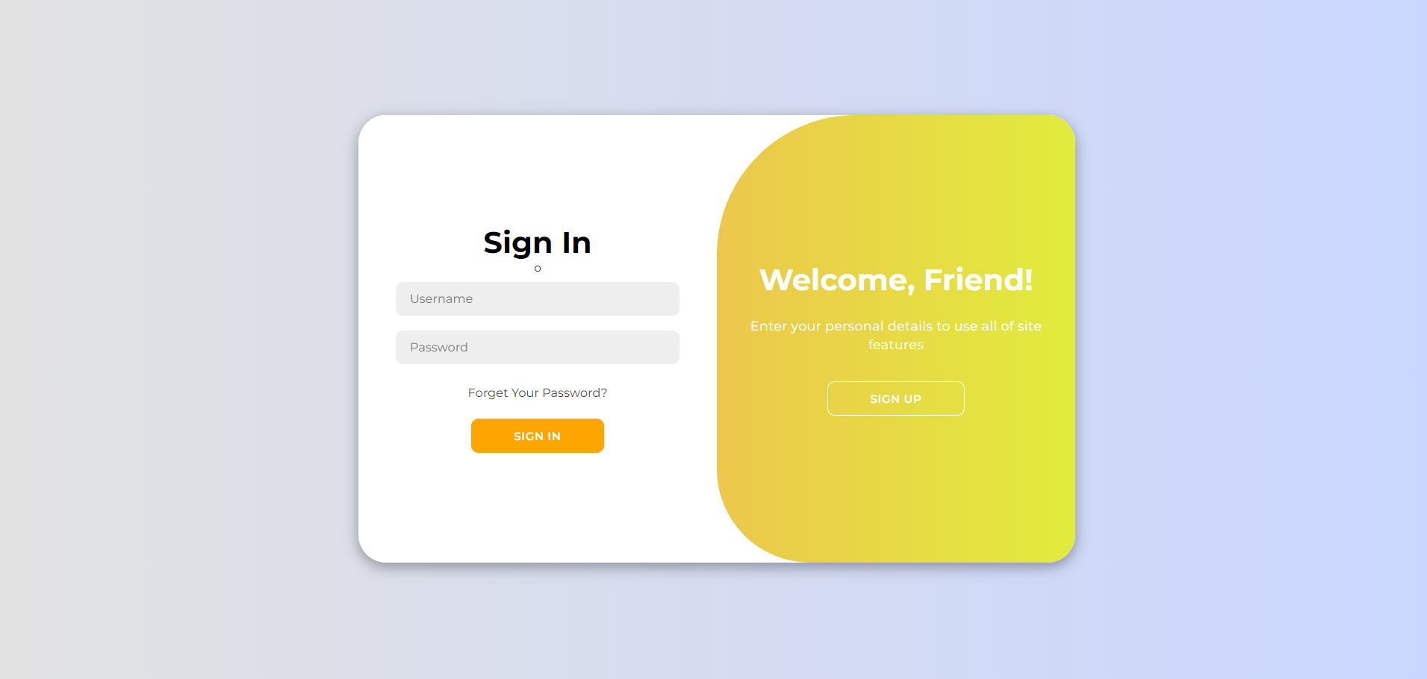
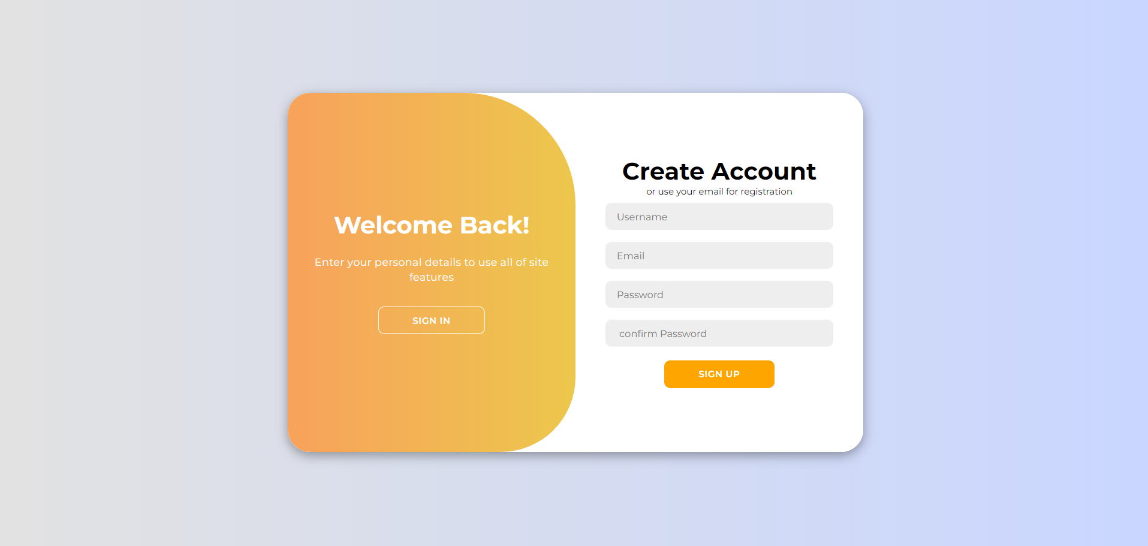
ENHANCING USER EXPERIENCE BY LEVERAGING WEB SCRAPING
35

Slide 36
ENHANCING USER EXPERIENCE BY LEVERAGING WEB SCRAPING
36

Slide 37
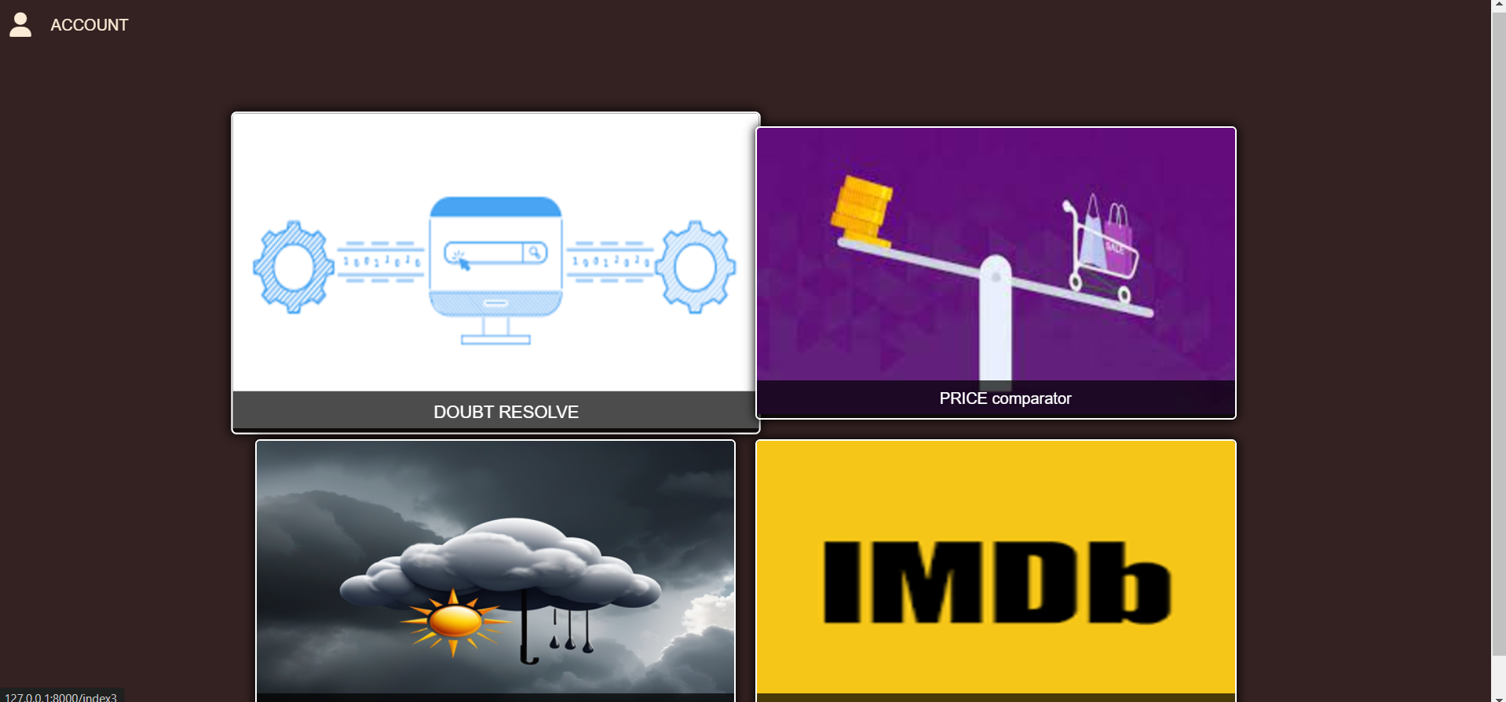
ENHANCING USER EXPERIENCE BY LEVERAGING WEB SCRAPING
37

Slide 38
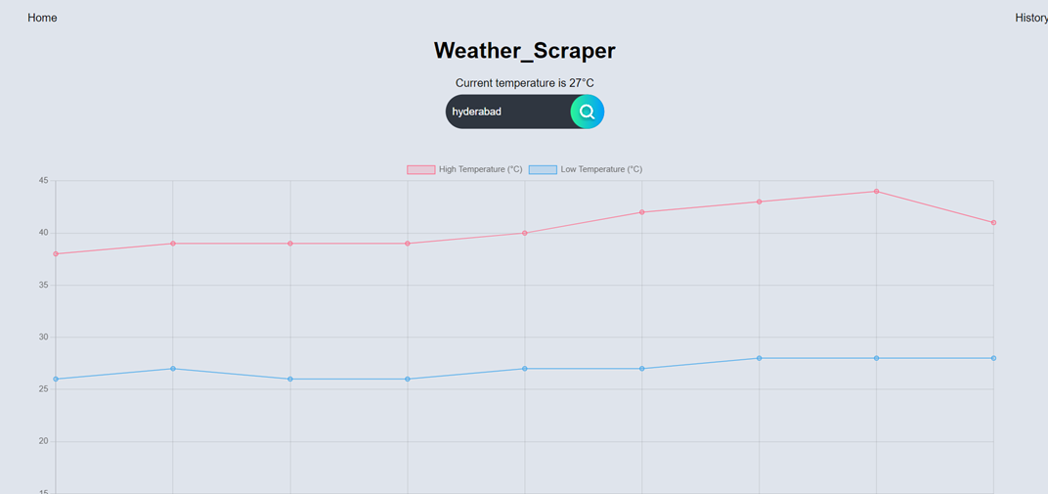
ENHANCING USER EXPERIENCE BY LEVERAGING WEB SCRAPING
38

Slide 39
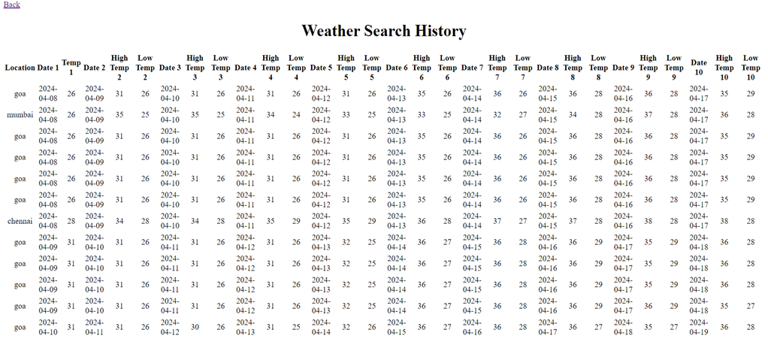
ENHANCING USER EXPERIENCE BY LEVERAGING WEB SCRAPING
39

Slide 40
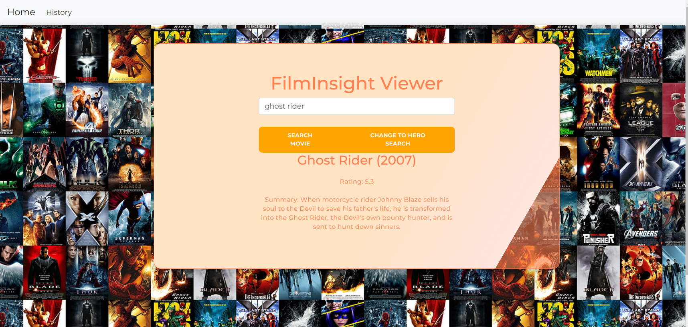
ENHANCING USER EXPERIENCE BY LEVERAGING WEB SCRAPING
40

Slide 41
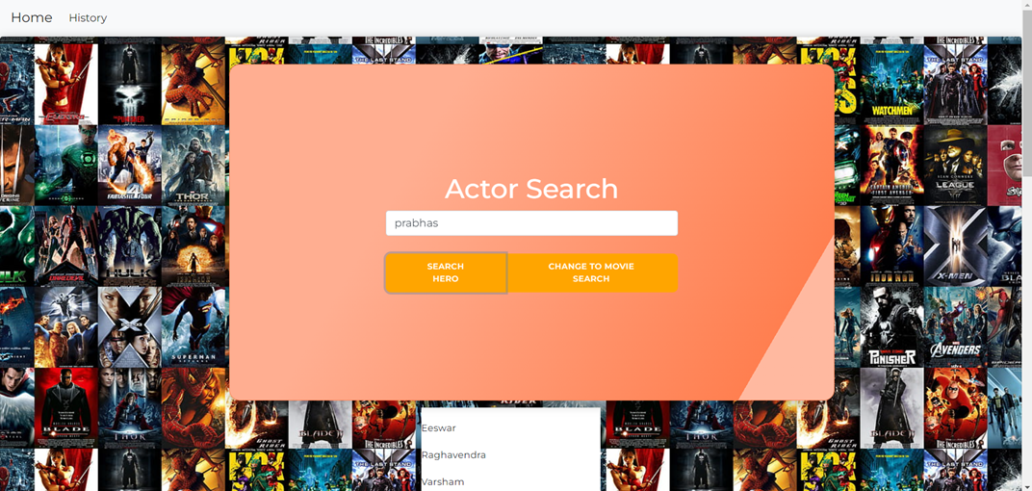
ENHANCING USER EXPERIENCE BY LEVERAGING WEB SCRAPING
41

Slide 42
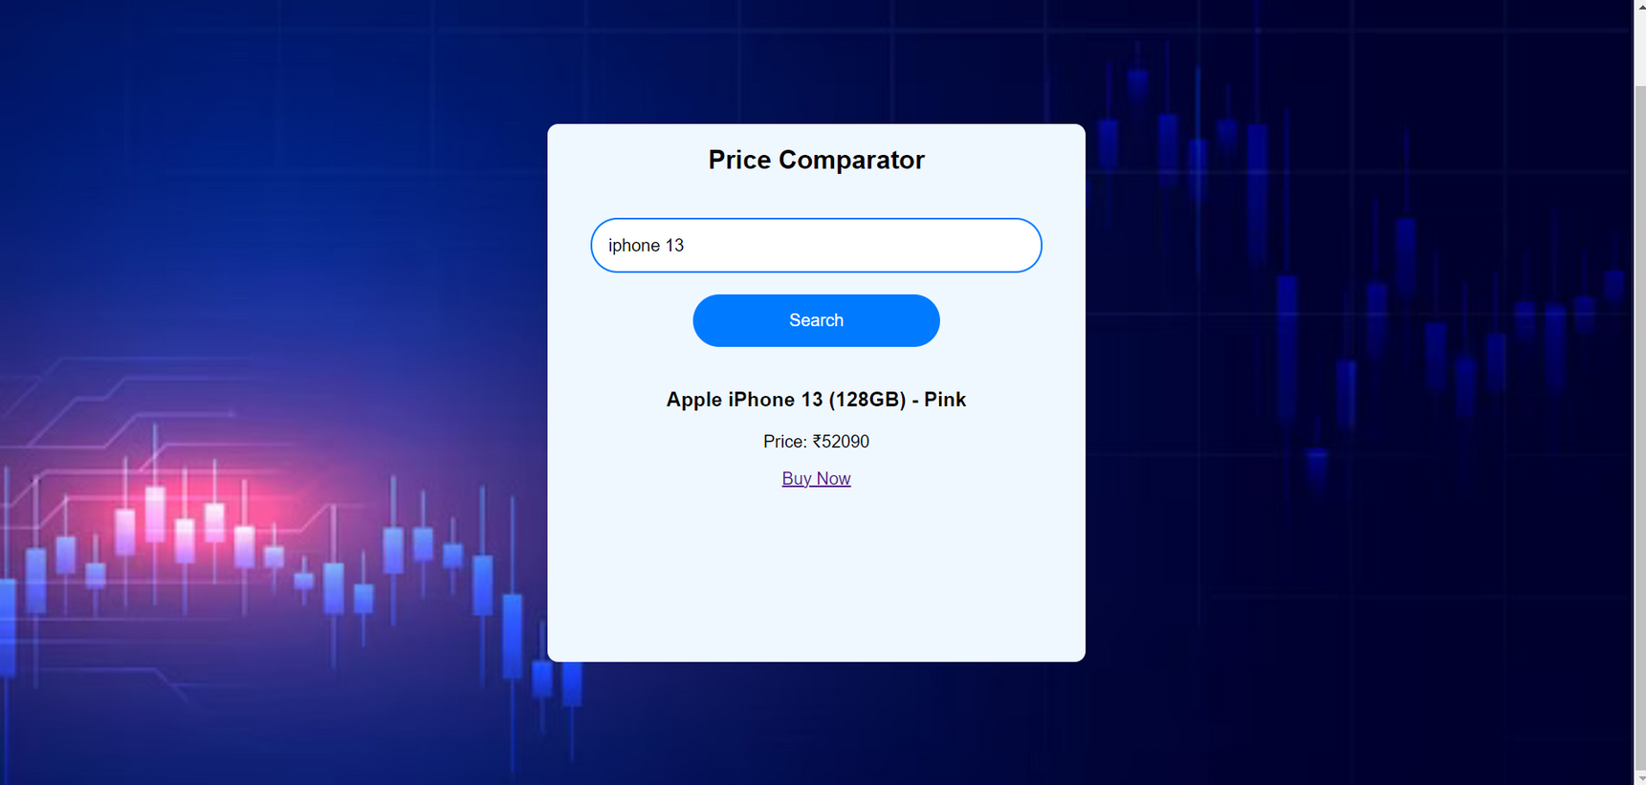
ENHANCING USER EXPERIENCE BY LEVERAGING WEB SCRAPING
42

Slide 43
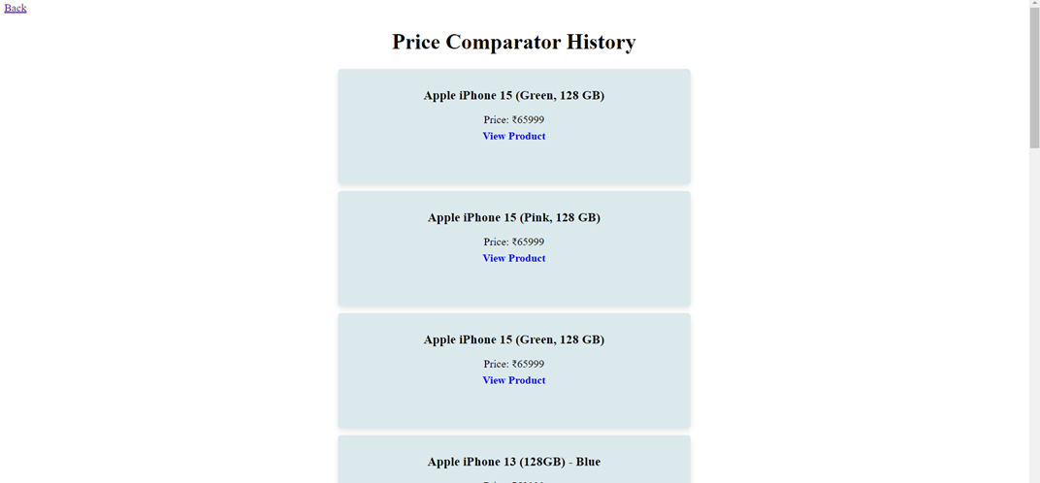
ENHANCING USER EXPERIENCE BY LEVERAGING WEB SCRAPING
43

Slide 44
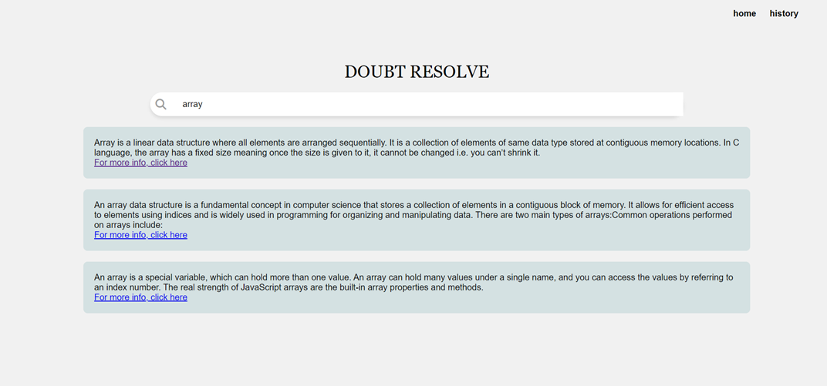
ENHANCING USER EXPERIENCE BY LEVERAGING WEB SCRAPING
44

Slide 45
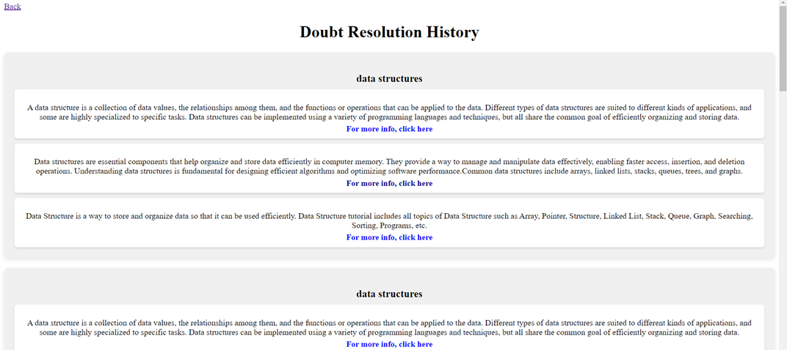
ENHANCING USER EXPERIENCE BY LEVERAGING WEB SCRAPING
45

Slide 46
CONCLUSION
In conclusion, our project utilizes advanced web scraping techniques to automate data extraction from various websites, addressing the challenge of scattered information and manual searching. By organizing data into structured formats and offering customized retrieval options, we enhance user experience and efficiency. Additionally, our applications significantly boost performance, ensuring swift and accurate data extraction. Overall, our project empowers users providing direct access to relevant information.
46

Slide 47
Thank you
for listening!

